Slide 1
Exploring African American Firsts
Group 10
Brigita, Deniz, Lujia, Marco, Martino, Noor

Slide 2
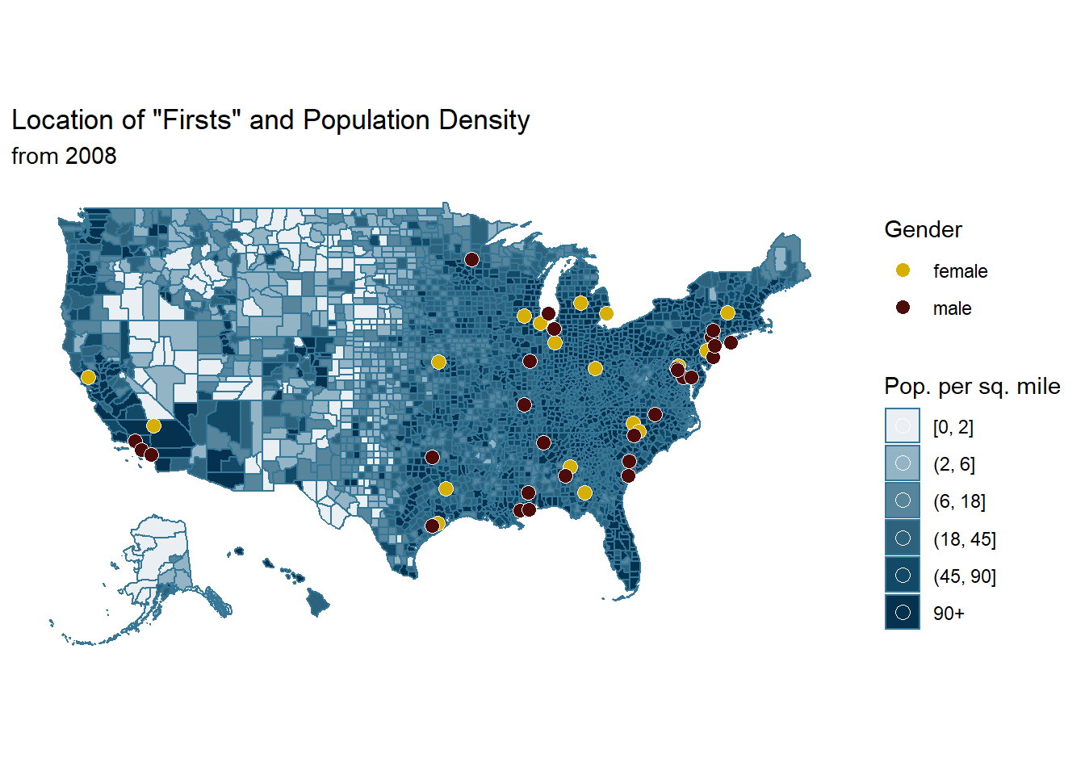
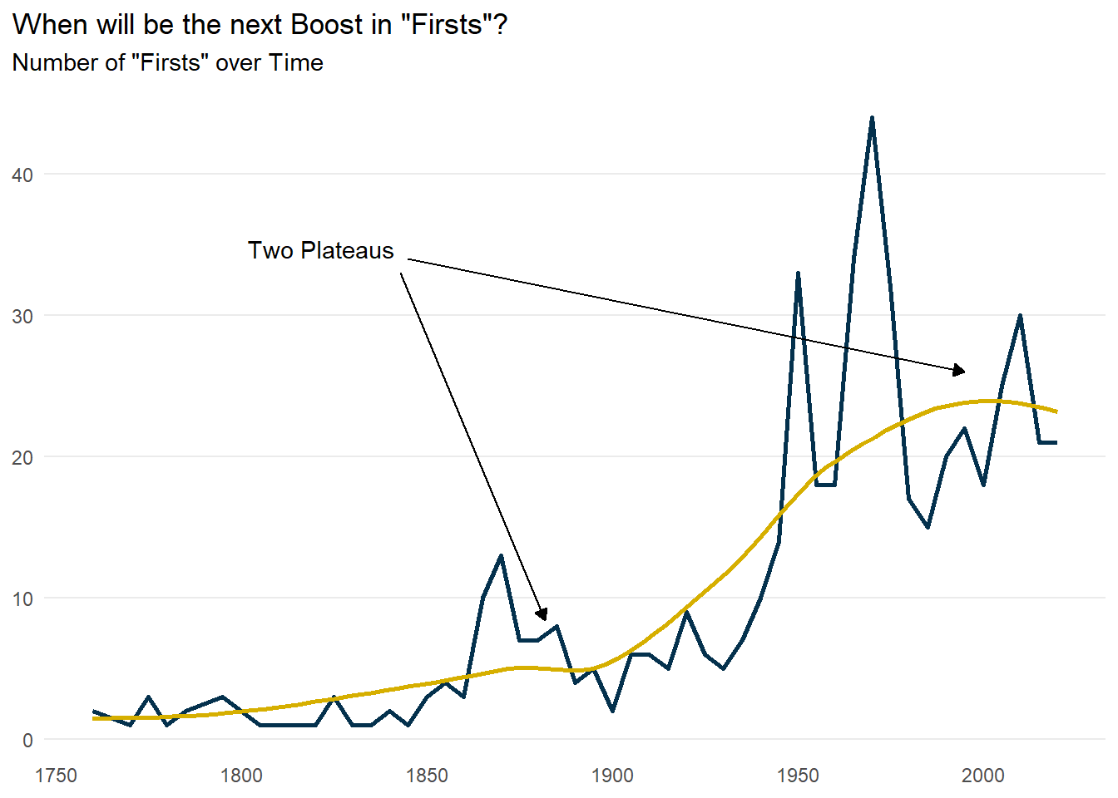
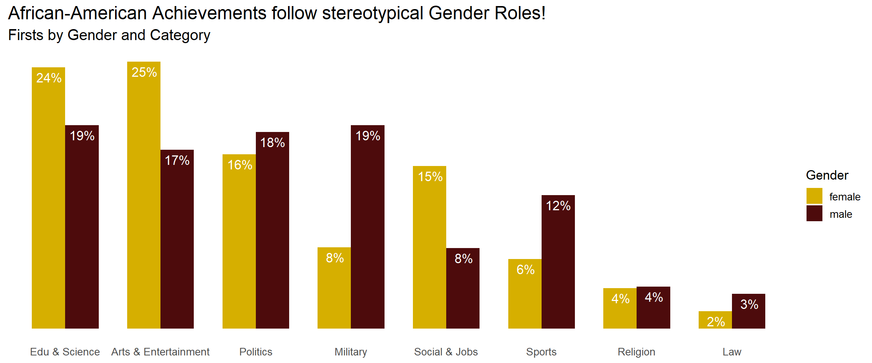
Scrapping Data to Visualizations
Two-step approach in creating visualizations
1
2
Data Scrapping & Wrangling
EDA & Visualizations
Data Source: Wikipedia
Data Source: Wikipedia
African American Firsts
Individual Demographic Information
Clean Data
Enriching Data by Adding Location & Gender
Clean Data & Add Shape Files
EDA

Slide 3
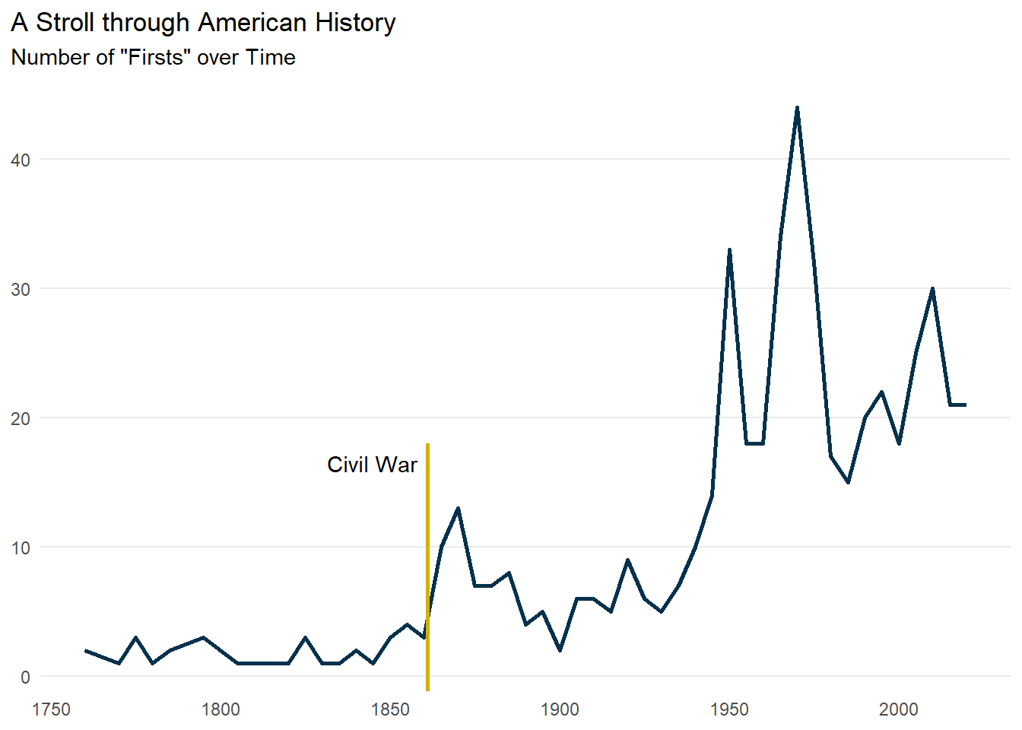
Low Number of Firsts Before the Civil War
Number of Firsts Averaged at Less Than 5 Firsts Before 1861

Slide 4
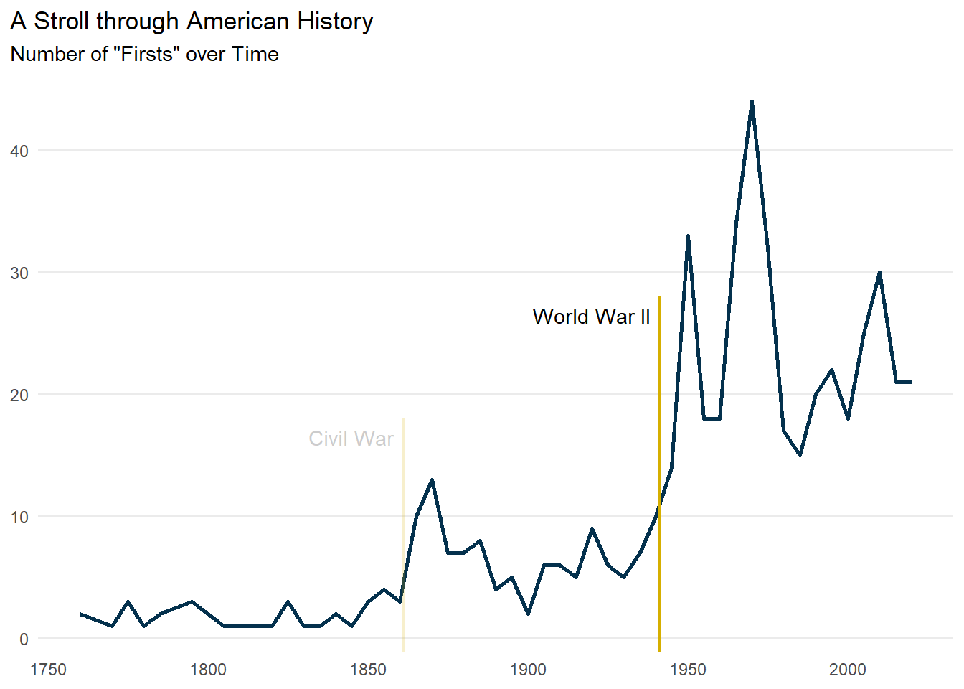
Number of Firsts Dramatically Increase After WWII
Average of Number of Firsts Increase to ~ 25 After WWII

Slide 5
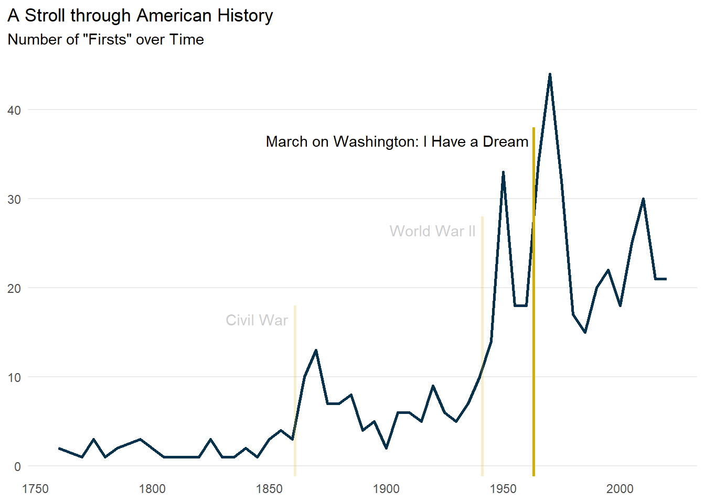
MLK’s Speech Revolutionized The African Movement
Average of Number of Firsts Increase to ~ 35 After MLK’s Speech

Slide 6
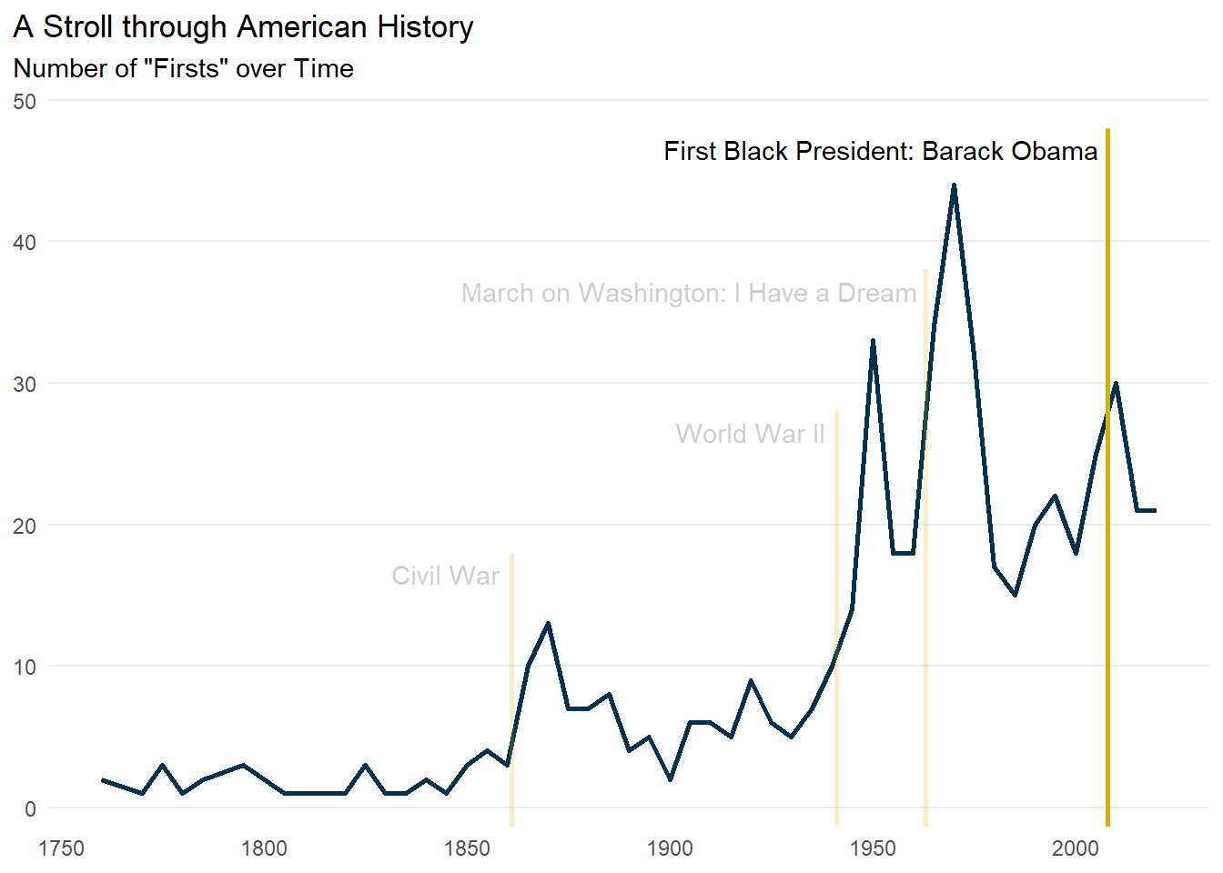
Number of Firsts Plateau After Obama’s Election
Average of Number of Firsts Plateaus at ~ 30 After Obama’s Election

Slide 7
Will the Number of Firsts Plateau or Increase?
Two Plateaus can be seen since 1750

Slide 8
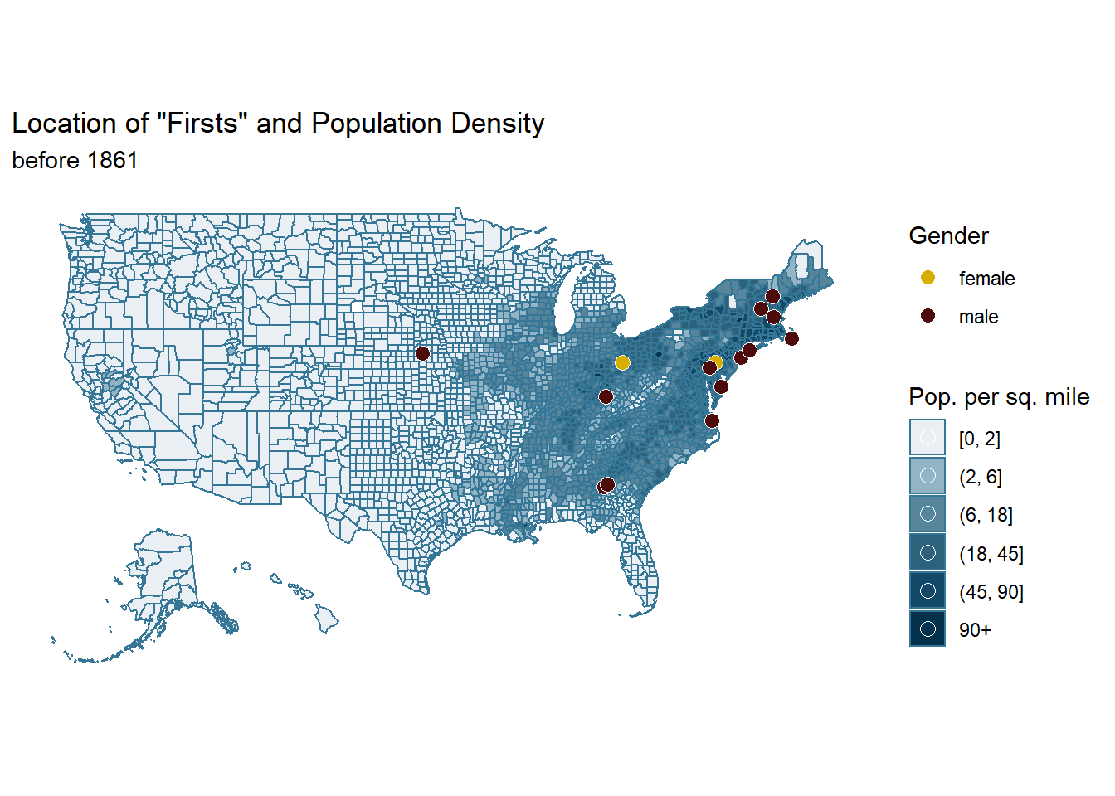
High Growth in Number of Firsts in High Density Areas
Migration of African American Firsts Follows Migration of Population
Notes:
Mention black migration to the west has also caused the increase in number of firsts

Slide 9
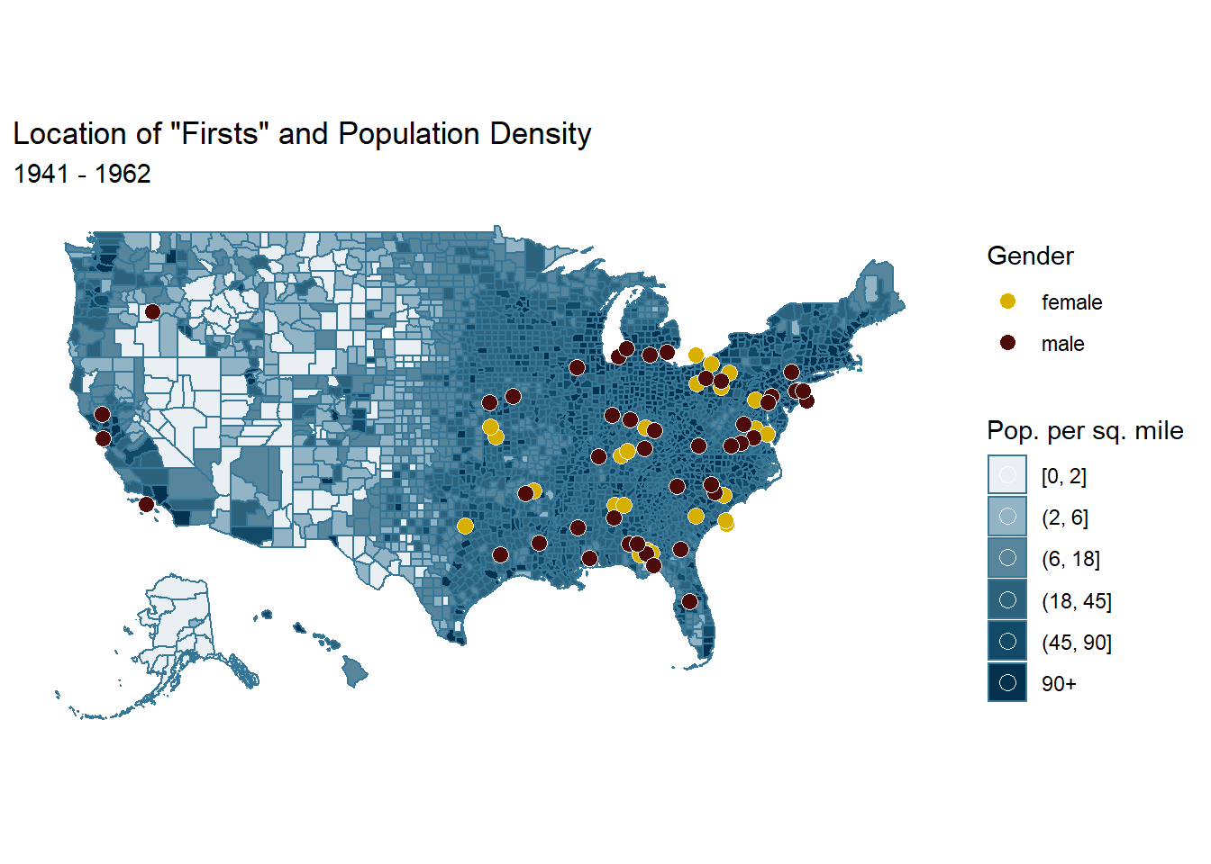
High Growth in Number of Firsts in High Density Areas
Migration of African American Firsts Follows Migration of Population
Notes:
Mention black migration to the west has also caused the increase in number of firsts

Slide 10
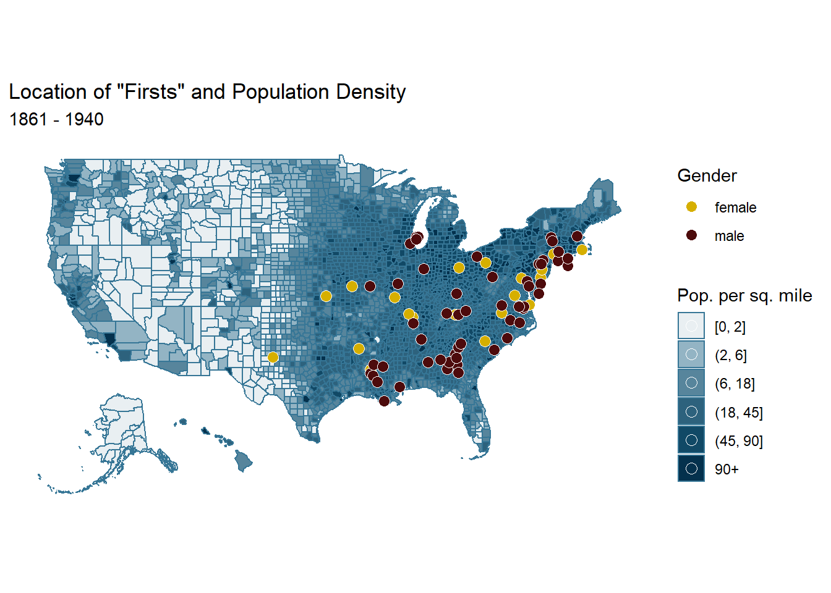
High Growth in Number of Firsts in High Density Areas
Migration of African American Firsts Follows Migration of Population
Notes:
Mention black migration to the west has also caused the increase in number of firsts

Slide 11
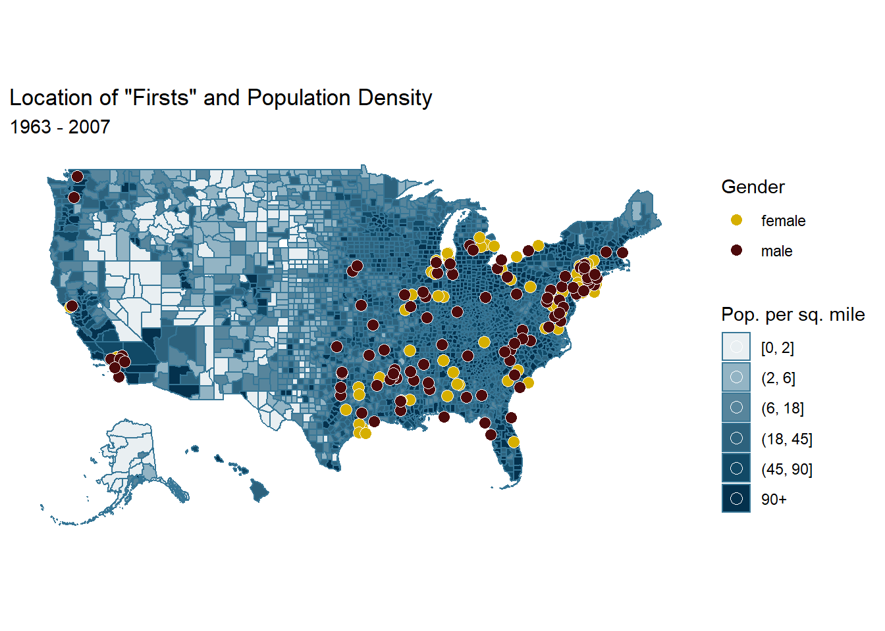
High Growth in Number of Firsts in High Density Areas
Migration of African American Firsts Follows Migration of Population
Notes:
Mention black migration to the west has also caused the increase in number of firsts

Slide 12
Dispersion of Firsts have Stabilized over the Decade
Unequal Number of Female and Male Firsts Still Persists

Slide 13
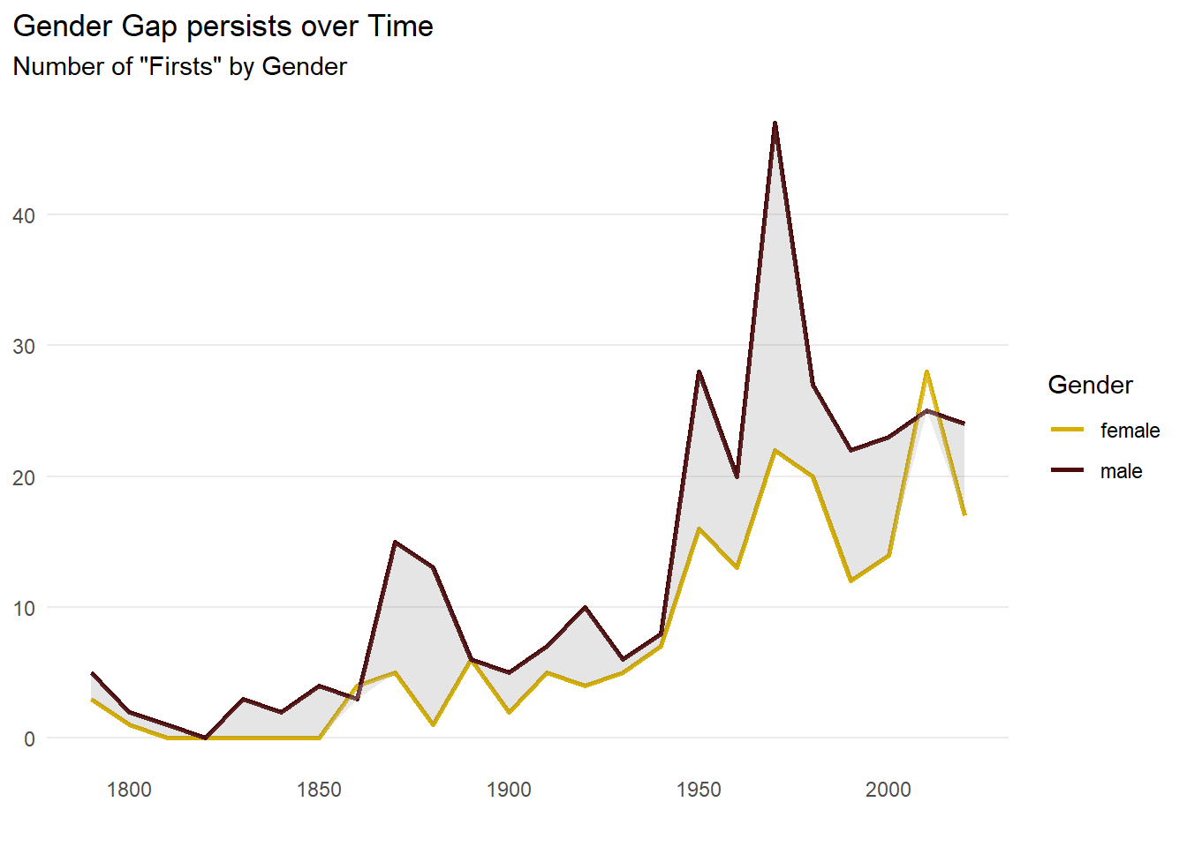
Gender Disparity Greatest for 1975
Number of Male Firsts have Exceeded Number of Women Firsts in Most Years

Slide 14
Decision Roles Has Largest Number of Male Firsts
Number of Male First Surpass Number of Female First Most for Politics and Military

Slide 15
Backup

Slide 16
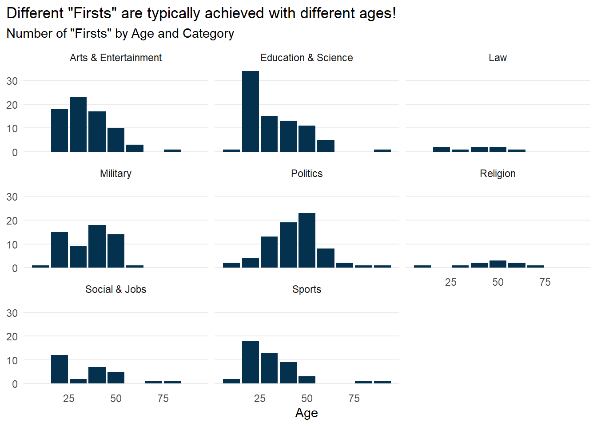
Stark Difference in Ages Between Categories
Politics have Eldest Firsts Amongst Other Categories

Slide 17
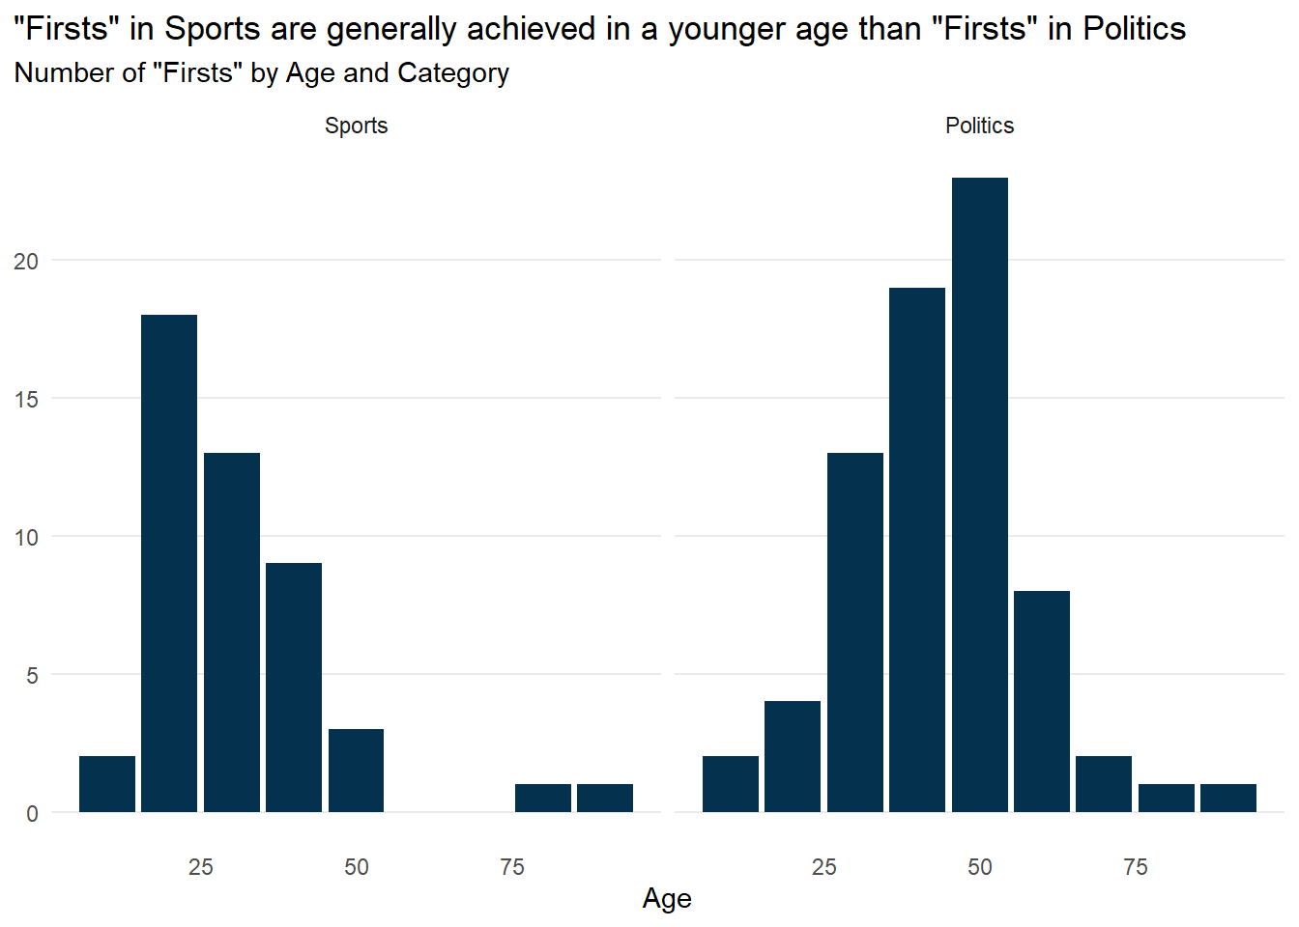
Differences in Age Distribution in Sports and Politics
Highest Spike of Sports First Occur at 20 and at 45 for Politics

Slide 18
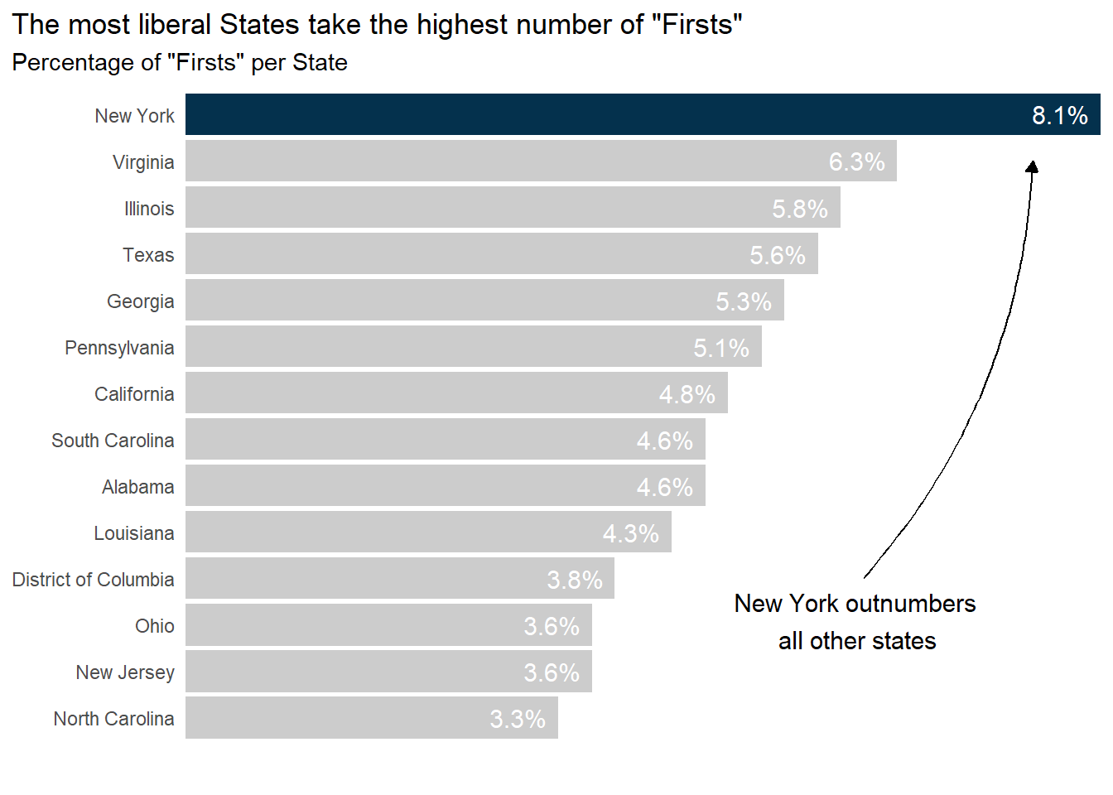
New York has Highest Number of Firsts
8.1% of the Firsts Occur in the State of New York

Slide 19
Thank you! Any Questions?

